Slide 1
C# delegates
By,
Deepthi R
Pit Solutions

Slide 2
UNDERSTANDING DELEGATES IN C#
A delegate is a reference type that holds the reference of a class method. Any method which has the same signature as delegate can be assigned to delegate. It is very similar to the function pointer but with a difference that delegates are a type-safe. We can say that it is the object-oriented implementation of function pointers.
Delegates are especially used for implementing events and the call-back methods. All delegates are implicitly derived from the System.Delegate class.

Slide 3
There are three steps for defining and using delegates:
1. Declaration A delegate is declared by using the keyword delegate, otherwise it resembles a method declaration.
SYNTAX: <Access specifier>delegate <return type> <delegate-name> <parameter list>
2. Instantiation To create a delegate instance, we need to assign a method (which has same signature as delegate) to delegate.
SYNTAX:
public delegate void printString(string s); ...
printString ps1 = new printString(WriteToScreen);
printString ps2 = new printString(WriteToFile);
3. Invocation Invoking a delegate is like as invoking a regular method.

Slide 4
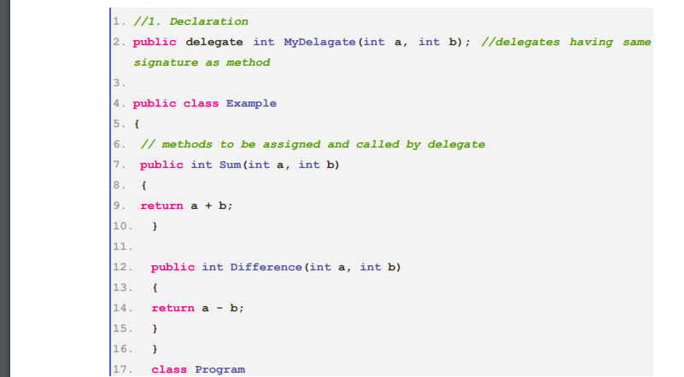

Slide 5
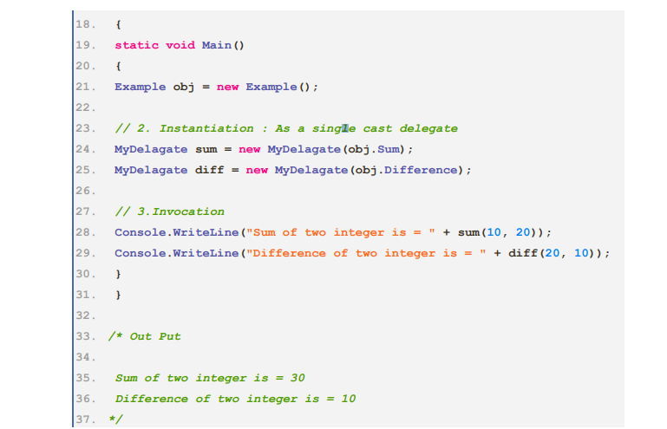

Slide 6
Key points about delegates
1. Delegates are like C++ function pointers but are type safe.
2. Delegates allow methods to be passed as parameters.
3. Delegates are used in event handling for defining callback methods.
4. Delegates can be chained together i.e. these allow defining a set of methods that executed as a single unit.
5. Once a delegate is created, the method it is associated will never changes because delegates are immutable in nature.

Slide 7
6. Delegates provide a way to execute methods at run-time.
7. All delegates are implicitly derived from System.MulticastDelegate, class which is inheriting from System.Delegate class.
8. Delegate types are incompatible with each other, even if their signatures are the same. These are considered equal if they have the reference of same method.

Slide 8
Types of delegates
1. Single cast delegate A single cast delegate holds the reference of only single method. In previous example, created delegate is a single cast delegate.
2. Multi cast delegate A delegate which holds the reference of more than one method is called multi-cast delegate. A multicast delegate only contains the reference of methods which return type is void. The + and += operators are used to combine delegate instances. Multicast delegates are considered equal if they reference the same methods in the same order.

Slide 9
THANK YOU

